Slide 1
AI Smart Customer Support
Group Members:
1)Swarupanand Bajbalkar
2)Samruddhi Shingade
3)Rutuja Puranik
4)Mrudula Waghmode
Under Guidance of:
Miss . Varsha Kamble

Slide 2


The Challenge: Broken Customer Support
Most organizations struggle with traditional customer support systems that are slow, manual, and inefficient, leading to dissatisfied customers and operational bottlenecks.
Slow & Manual Processes
Reliance on manual effort for every query causes significant delays and limits scalability.
Poor Customer Satisfaction
Delayed responses and unresolved issues lead to frustrated customers and damaged brand loyalty.
No Intelligent Routing
Manual ticket categorization is error-prone and prevents quick resolution by the right team.
Missed Emotional Cues
Lack of sentiment detection means critical customer frustration often goes unnoticed and unaddressed.

Slide 3





Objective: AI-Smart Customer Support
We propose an advanced system designed to revolutionize customer support through AI, automation, and intelligent insights.
Instant AI Chatbot
Automated Ticket Creation
NLP Sentiment & Intent
Provides immediate assistance for common queries, reducing human intervention.
Seamlessly escalates complex issues to human agents with automatic ticket generation.
Utilizes Natural Language Processing to understand customer emotion and query purpose.
Rich Admin Panel
Secure Authentication
Offers detailed analytics and visual reports for informed decision-making and performance improvement.
Ensures data protection with industry-standard JWT for authorized access.

Slide 4

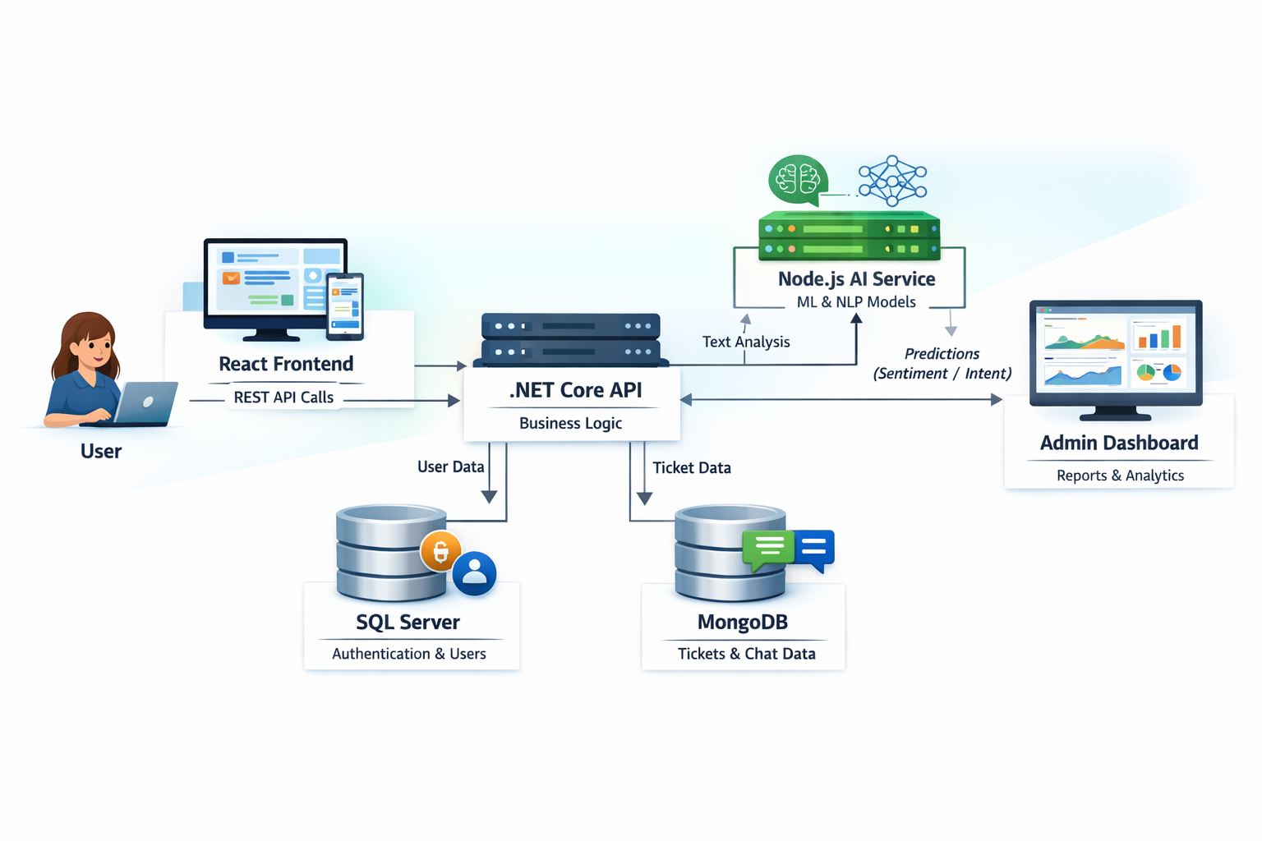
System Architecture: Overview
This diagram illustrates the interconnected components of our AI-powered customer support system, highlighting the flow of data and interactions.
The architecture is designed for modularity, scalability, and efficiency, integrating various technologies to deliver a seamless customer support experience.

Slide 5
Technology Stack
1. React Frontend (UI Layer)
Working:
Shows all screens: Login, Chatbot, Tickets, Dashboard
Sends/receives data via API (Axios/Fetch)
Displays chatbot replies, ticket status & analytics
Why: Fast UI, real-time interaction, smooth API integration
2. .NET Core Backend API (Main Logic Layer)
Working:
Handles all business logic
Validates users via JWT
Manages tickets, users, analytics
Communicates with SQL Server, MongoDB & AI service
Why: Secure, fast, scalable, industry-standard
3. SQL Server (Authentication DB)
Stores: Users, Password Hash, Role (User/Admin)
Why:
Best for structured relational data
Highly secure login system

Slide 6
Technology Stack
4. MongoDB (Tickets + Chat DB)
Stores: Tickets, chat logs, sentiment, classifications
Why:
Flexible schema
Fast read/write
Perfect for unstructured support data
5. Node.js AI Microservice (ML/NLP Engine)
Working:
Receives messages from backend
Predicts sentiment, intent, category
Generates chatbot replies
Why:
Runs AI separately → better performance
Easy to upgrade ML models
6. Chatbot Engine (Rule-based + AI)
Working:
Answers common queries using predefined rules
Uses AI for advanced replies
Creates tickets when unable to answer
Example:
User: “I am frustrated.”
Bot: “I’m sorry for the trouble, creating a ticket now.”

Slide 7

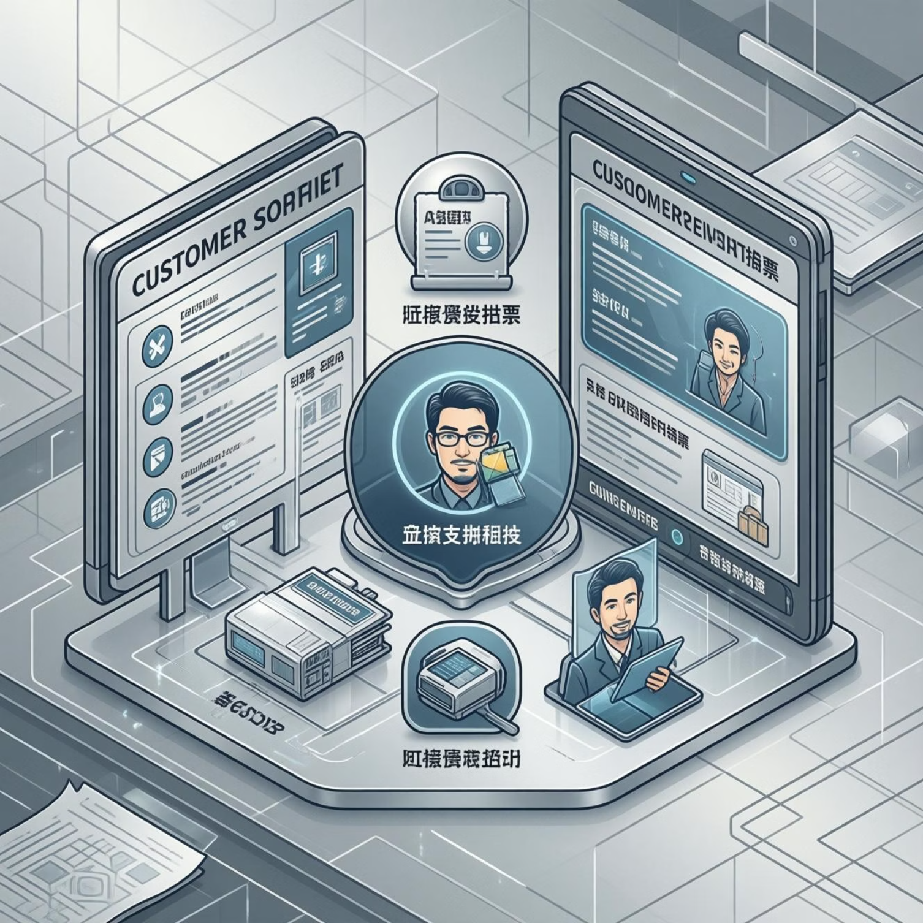
Datasets Used: Sentiment & Classification
We leverage carefully selected datasets to train our AI models for accurate sentiment analysis and ticket categorization.
Sentiment Analysis Dataset
Ticket Classification Dataset
Used for detecting whether the customer's message is Positive / Negative / Neutral.
Utilized for predicting the precise type of support ticket, such as:
Best Options: Twitter Sentiment Dataset (Kaggle),
Amazon Reviews Dataset (Kaggle)
Categories: Technical Issue, Billing Issue, Account/Login Issue, General Query
Best Options: Customer Support Ticket Classification (Kaggle),
IT Helpdesk Ticket Dataset (Kaggle)
Why We Use It: Text format closely matches customer complaints,
and data is pre-labeled for easy training with simple ML models.
Why We Use It: Contains real helpdesk queries, clean text,
and is a perfect fit for our AI classification module.

Slide 8
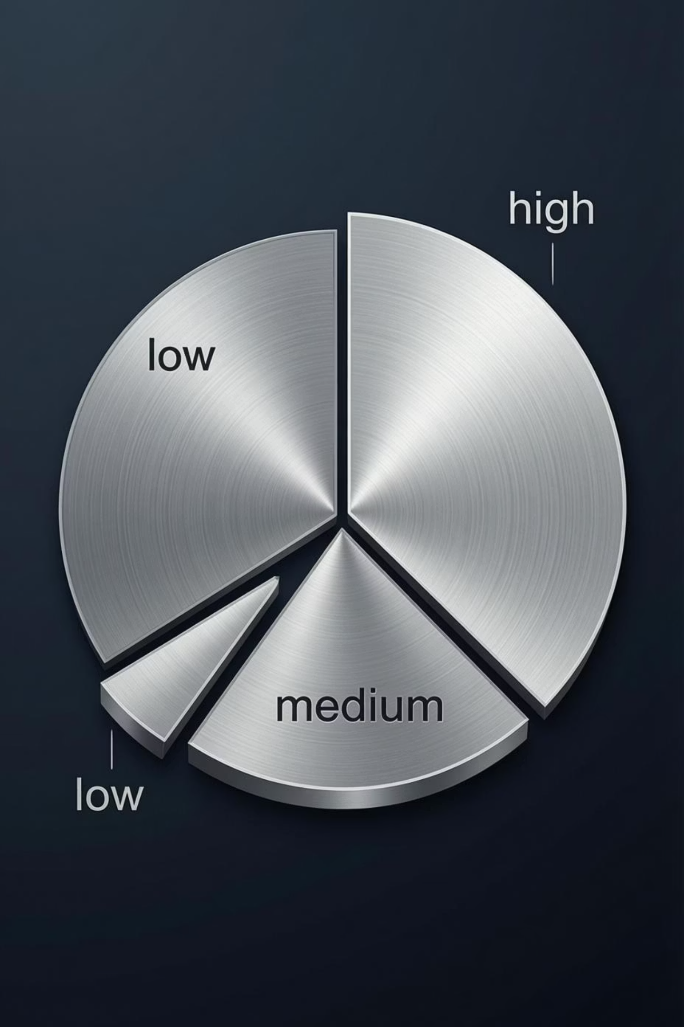
Datasets Used: Priority Prediction
For predicting ticket priority, we rely on a combination of established and custom datasets to ensure relevance and accuracy.
Priority Prediction Dataset
Best Options
IT Ticket Severity Dataset (Kaggle)
Used to predict ticket priority as Low / Medium / High, ensuring urgent issues are addressed promptly.
Custom Mini Dataset (100–150 labeled samples)
Why Custom Dataset Works
Priority is often subjective, making smaller, tailored datasets effective.
Simple ML models perform well without needing vast amounts of data.
Allows for student-created datasets, fostering hands-on learning and customization.

Slide 9
Future Scope Implemented
Our system is designed with future growth in mind, with several key enhancements already identified for continuous improvement.
1
Priority Prediction Model
Adding a machine learning model (e.g., Naive Bayes) to automatically assign ticket priority (Low, Medium, High) based on text content.
2
Improved Sentiment Analysis
Upgrading the rule-based approach with lightweight, pre-trained models like VADER or TextBlob for more accurate emotion detection.
3
Intent Classification for Chatbot
Implementing a classifier to categorize user messages (General Query, Billing Issue, Technical Issue) for smarter chatbot responses.
4
Admin Analytics Additions
Integrating Chart.js for advanced visualizations, including sentiment distribution, ticket trends, and category-based performance charts.
5
Email Notification System
Developing a feature to send automated email alerts to users regarding ticket creation and status updates.

Slide 10
Research Paper
[1] C. S. Kanimozhi Selvi, S. J. Shri, R. Prasshanthini, N. Neelamegan and R. Sanjay, “Customer Support Ticket Categorization and Prioritization Using Natural Language Processing,” in Proc. 3rd Int. Conf. Futuristic Technology (INCOFT), 2025. :contentReference[oaicite:7]{index=7}
[2] R. Jayadi, “Sentiment Analysis of Digital Customer Service Helpdesk Tickets: A Comparison between BERT and SVM,” Proc. 2024 Int. Conf. Computer Eng., Network, and Intelligent Multimedia (CENIM), 2024. :contentReference[oaicite:8]{index=8}
[3] N. Koka, “Enhancing a Ticketing System with AI Intelligence,” IJERT, vol. 13, no. 07, Jul. 2024. :contentReference[oaicite:9]{index=9}
[4] P. Kumari et al., “Online Chatbot Based Ticketing System,” Int. J. Sci. Res. & Eng. Trends (IJSRET), vol. 10, no. 6, Nov-Dec 2024. :contentReference[oaicite:10]{index=10}
[5] S. Uzan, D. Freud, and A. Elalouf, “Optimizing Chatbots to Improve Customer Experience and Satisfaction,” *Appl. Sci.*, vol. 15, no. 17, 2025. :contentReference[oaicite:11]{index=11}
[6] S. Hewage Wewelwala and T. G. D. K. Sumanathilaka, “Hybrid Emotion Recognition: Enhancing Customer Interactions Through Acoustic and Textual Analysis,” *arXiv*, 2025. :contentReference[oaicite:12]{index=12}
[7] M. Truss and S. Boehm, “AI-based Classification of Customer Support Tickets: State of the Art and Implementation with AutoML,” *arXiv*, 2024. :contentReference[oaicite:13]{index=13}

Slide 11





Conclusion: A Future-Ready Support System
Our project delivers a modern AI-powered customer support system that significantly improves response speed and operational efficiency.
Enhanced Speed & Efficiency
Automates ticket creation and streamlines workflows, drastically reducing manual effort.
Intelligent Decision-Making
Leverages AI analytics for sentiment, intent, and priority to empower informed strategic choices.
Practical & Enterprise-Capable
Combines full-stack technologies with advanced AI, providing a robust solution for real-world industry needs.
Modular & Scalable
Built for easy integration of new features and advanced AI models, ensuring long-term adaptability and performance.

